Slide 1
Internet Application Development
Group # 02 (Weekly challenge)

Slide 2
Content
Question From the book………………………………………………………3
Question comprehension……………………………………………………..4
Flowchart…………………………………………………………………………7
Links……………………………………………………………………….8
Game Guide: How to Play (in desktop)…........………………………...…9
Game Guide: How to Play (in mobiles).…........………………………...…10
Ending……………………………………………………………………………..11

Slide 3
Project: 4.23
Consider a two-player game played with pegs of six different colors. One player (the encrypter) selects four pegs of different colors and places them in a certain order (leftmost through rightmost). This is the encrypted message, and is not shown to the second player (the decrypter). The decrypter then selects four pegs and places them in an order from left to right; this is the decrypter’s guess about what the encrypted message is. Next, the encrypter leaksinformation about the encrypted message by placing small black or white pegs next to the guessed pegs; these pegs define a score for the guess. A black scoring peg indicates that one of the guessed pegs is exactly right: right color and in the right position. A white scoring peg indicates that a guessed peg is the right color but in the wrong position. So two black scoring pegs and one white would mean that three of the guessed pegs are of the right color and that two of these are in the correct position within the guessed peg ordering. Once a guess has been scored, the decrypter guesses a second time, and the encrypter scores this guess. (See Figure 5.35 for a graphical representation of such a game after two guesses have been scored.) This continues until the decrypter fully guesses the secret code (score of four black pegs).
Write a JavaScript program that plays a text version of this game. The program should simulate the encrypter, and the human player will be the decrypter. Specifically, the program will randomly select a secret code consisting of four numbers between 1 and 6. The numbers should all be different. The program will then input and score each guess made by the decrypter (human player). In particular, the user will input four numbers in a prompt box, and the computer will score this guess against the secret. The computer will then output to an alert box the user’s guess and score (so many black and so many white pegs). If the score is 4 black, the game ends and the computer displays the total number of guesses made. Otherwise, the computer asks for another guess consisting of four numbers. Notice that the human is expected to write down his or her guesses and scores, because the computer will only output the most recent guess and score by the user each time. Your program does not need to verify that the user enters numbers between 1 and 6, since entering something else can only hurt the user’s chances of winning. You may also assume that all of the user’s four inputs for a guess are different numbers.
Question From the book

Slide 4




Question comprehension
Players:
The game involves two players:
The encrypter, who selects a secret code of 4 unique numbers (1–6) in a specific order.
The decrypter, who guesses this code.
The Goal:
The goal is to correctly guess the encrypted code using feedback provided by the encrypter.

Slide 5






How it works?
The program generates a random secret code with 4 unique numbers between 1 and 6.
The decrypter inputs a guess of 4 numbers.
What is the hint?
The program compares the guess to the secret code and provides a score:
Black pegs indicate a correct number in the correct position.
White pegs indicate a correct number in the wrong position.
What is the program’s outputs?
The program outputs the guess and its score.
For example, if the secret code is [2, 4, 6, 1] and the guess is [1, 4, 5, 6], the score would be 1 black (4) and 2 white (6, 1) .
Question comprehension

Slide 6




How the game ends?
The game ends when the score is 4 black pegs, meaning the code has been guessed correctly. The program displays the total number of guesses made. Otherwise, it prompts the user for another guess and repeats the process until the secret code is cracked.
How to Win? The player must keep track of their previous guesses and scores to strategize and refine their next guess. This process continues until the code is fully guessed.
Question comprehension

Slide 7
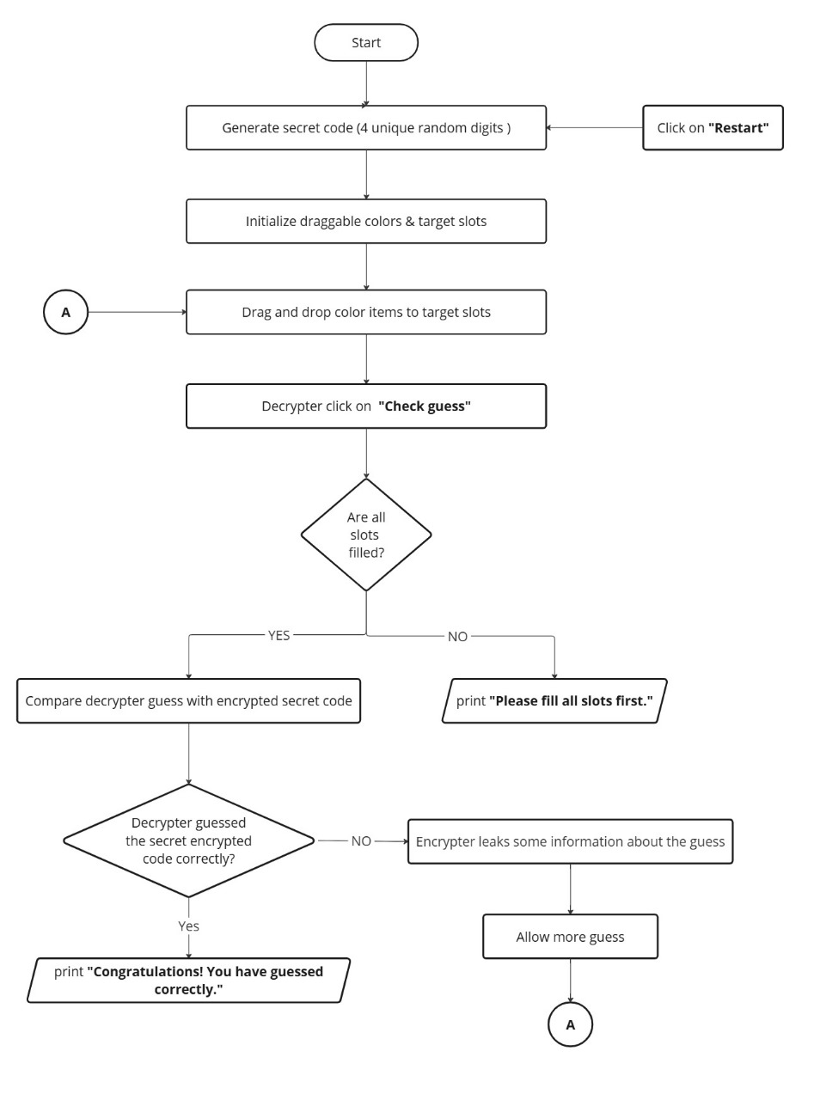
Flowchart

Slide 8




Game Code (Github Repo)
Master Mind Guessing Game (hosting link)
Links

Slide 9


Game Guide: How to Play (Desktop)
Drag & Drop: Click and drag a colored box into an empty slot.
Submit Your Guess: Click the “Check guess" button to check if your combination is correct.
Hint System:
Black ✔ = Correct number in the correct position.
White ⚪ = Correct number in the wrong position.
Red ❌ = Incorrect number.
Continue: Continue guessing until you crack the code!
Winning Condition: If all numbers are in the correct position, you win.
Restarting: Click the "Restart" button to start a new game with a new secret code.
Game guide

Slide 10

Game Guide: How to Play (Mobiles)
Tap & Select: Tap a colored box to select it. It will be highlighted.
Tap to Place: Tap an empty slot to place the selected box there.
Submit Your Guess: Press “Check Guess" to check your answer.
4. Hint System:
Black ✔ = Correct number in the correct position.
White ⚪ = Correct number in the wrong position.
Red ❌ = Incorrect number.
5. Continue: Continue guessing until you crack the code!
6. Winning Condition: If all numbers are in the correct position, you win.
7. Restarting: Click the "Restart" button to start a new game with a new secret code.
Game Guide

Slide 11

In a world of codes and secrets… The Encrypter sets the challenge… The Decrypter dares to break it… Strategy, logic, and skill decide the winner… This is more than just a game—it's a battle of minds!
A Very Special Thanks To Our Team Members Shaikh Muhammad Bilal
Isbah Ansari
Neha Noor
Waleed Alam Mallick
Muhammad Daniyal Khan
Farjad Zameer
Abdul Rehman Bin AmanUllah
Talha Ayub
Your feedback will help us to improve!
THANK YOU!

